Slide 1



Slide 2

GOALs
To analyze rental data to make better car purchase decisions by considering cost and revenue data.

Slide 3


TOOLS
Excel + Pivot Tables
Developed summary dashboards/charts to show analysis:
by make/model
by branch location
Cleaned and organized raw data
Used pivot tables to slice data and gain insights

Slide 4
Car Makes Insights
The chart show top10 cars have high performing, worth for investing plan.
Based on the data show that Shelby is the car have high profit.

Slide 5
The chart show top 10 cars has low profit.
Consider to limit invest or purchase.

Slide 6
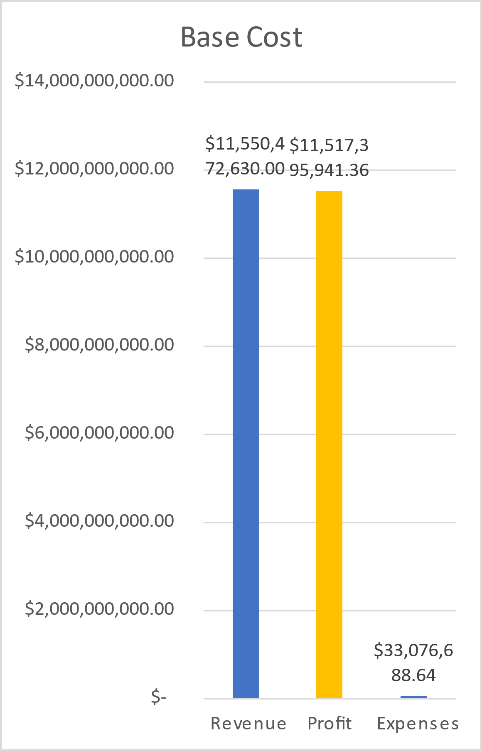
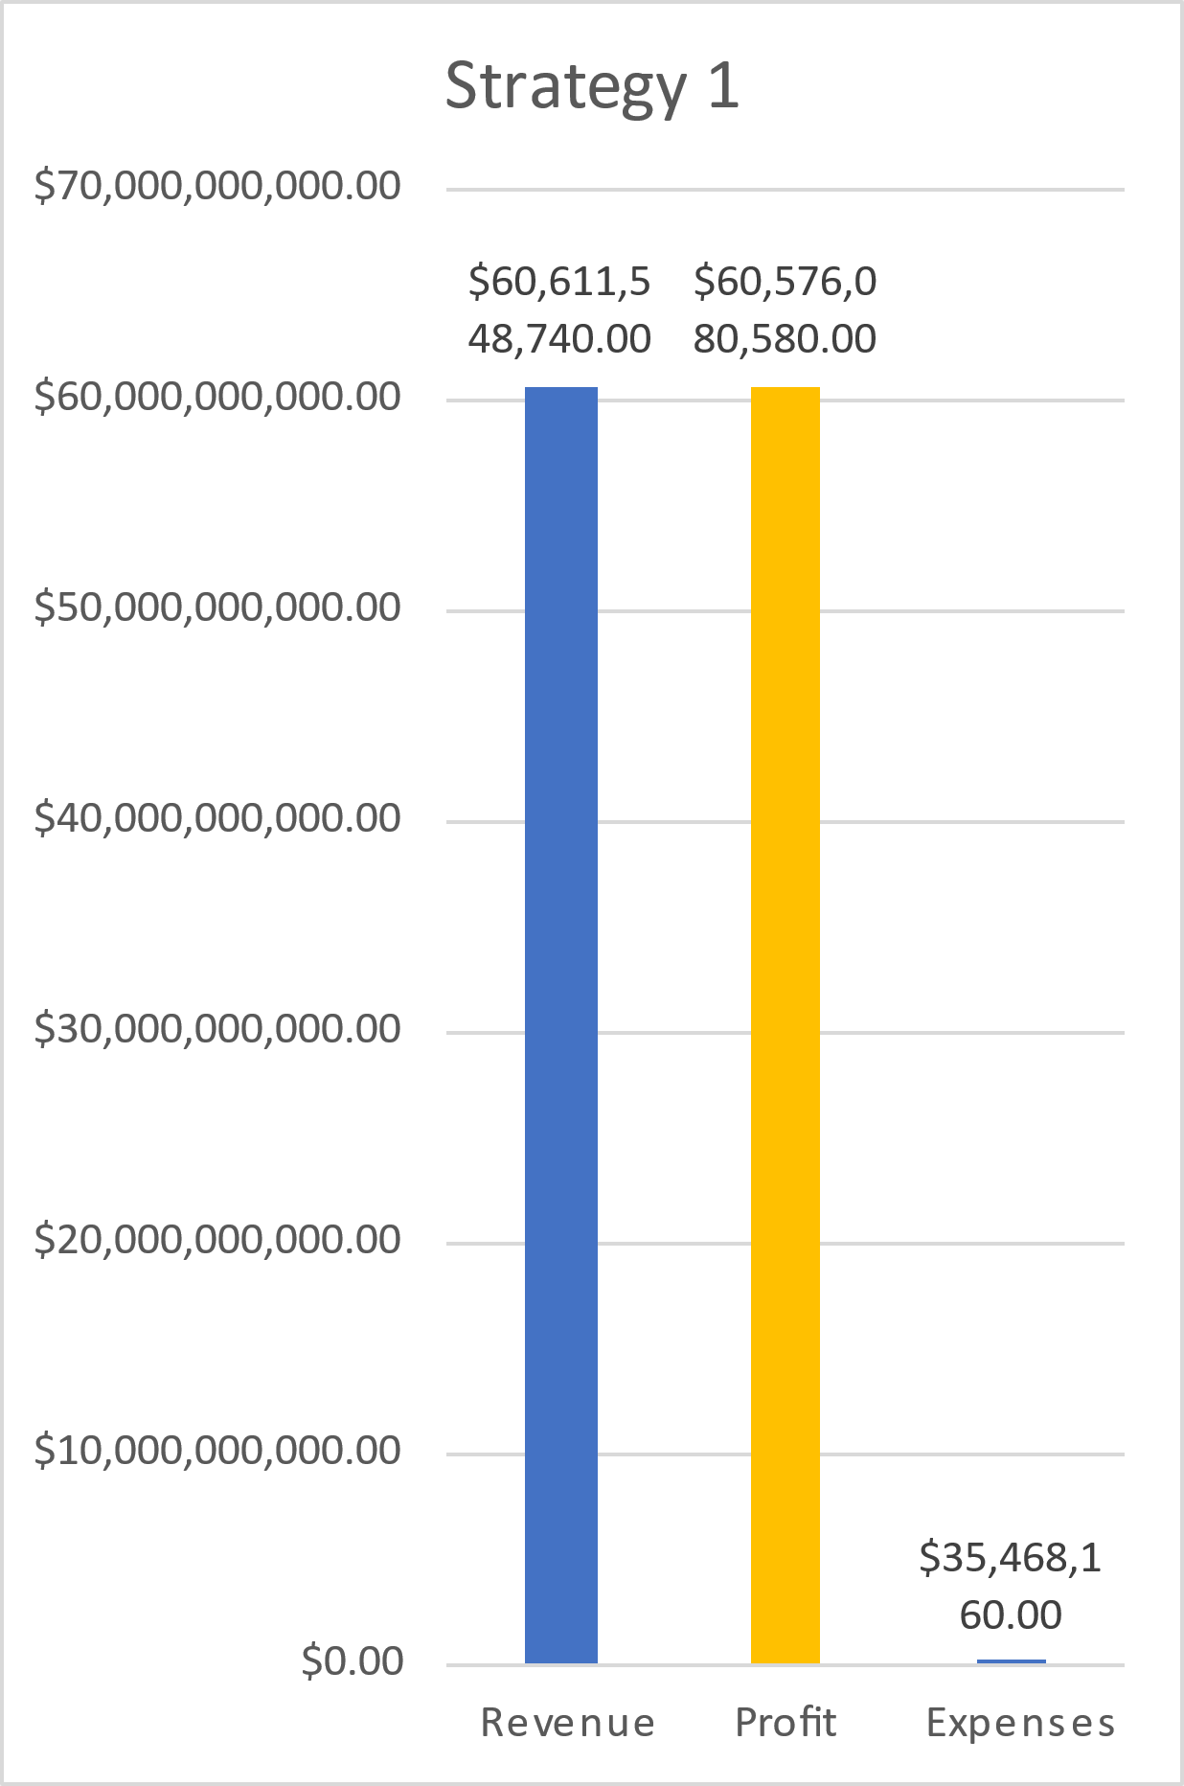
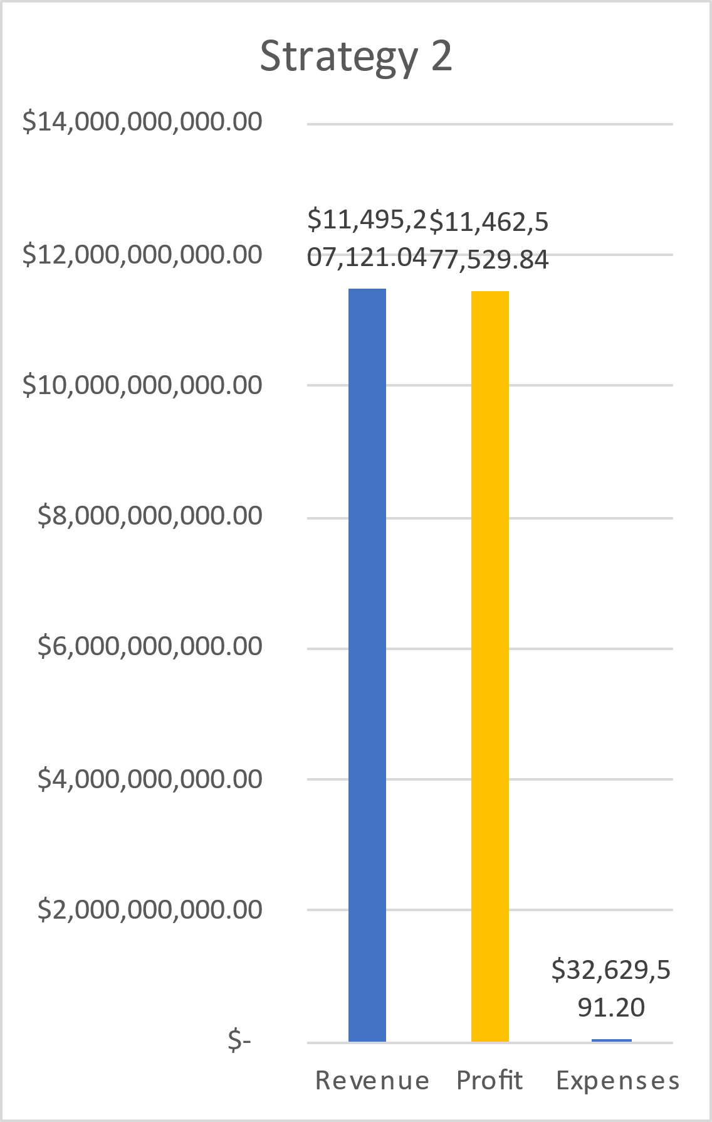
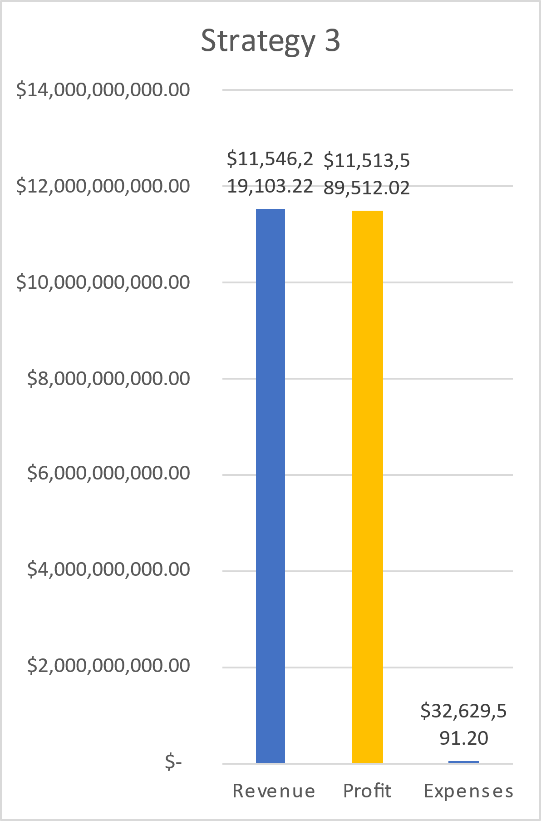
STRATEGIES
 | Find the top model again Shelby | Replace all of the poor performing cars with top model | Remove the poor performing cars
Base Cost | Strategy 1 - Switch all cars to Shelby | Strategy 2 | Strategy 3
$11,550,472,63.00 | $60,611,548,740.00 | $11,495,207,121.04 | $11,546,219,103.22
$11,517,395,941.36 | $60,576,080,580.00 | $11,462,577,529.84 | $11,513,589,512.02
$33,076,688.64 | $35,468,160.00 | $32,629,591.20 | $32,629,591.20
REVENUE
PROFIT
EXPENSE

Slide 7
Car Comparison by Models
The dashboard is about comparison between all cars model to Benchmark.
The data showing why Shelby is one of top car have high profit.

Slide 8
BRANCH INSIGHTS
These charts show Branch location near airport that have high rental car and less.
Based on the number of each branch location for purchasing decisions.

Slide 9
Summary/recommendation
Target on or adding Car models/makes valuable margins to the fleet based on high profit, revenues and expense.
Consider the models/makes that have high costs but worst performing valuable based on insurance, car cost.
look at the top performing cars in each branch for purchasing decisions.
Target more on the busy branch location and also limit car high cost at quiet branch location.
Notes:
My mentor and I reviewed the feedback. It appears that you are viewing the slide through the Google Drive viewer. This does not render Power Point files accurately. Please download the pptx file and open in Power Point to see the presentation in the proper format. This should resolve the issues provided in the feedback. I have also added some bullet points to slide 7 to make it clearer. Thank you!

Slide 10
THANK YOU

